Slide 1

SUREVEY APP
Personal Touch!
Nitin Salvankar
Sunand Pujari
Ushawini Vinnakota
Notes:
To use this title animation slide with a new image simply 1) move the top semi-transparent shape to the side, 2) delete placeholder image, 3) click on the picture icon to add a new picture, 4) Move semi-transparent shape back to original position, 5) Update text on slide.

Slide 2
INTRODUCTION
Goal:
Create a Survey Mobile App for patients.
Create a Web Portal for Admin.
Create APIs for communication with server.
Create Database for Data Storage.
ADVANCED MOBILE APPLICATION DEVELOPMENT: Homework 04

Slide 3
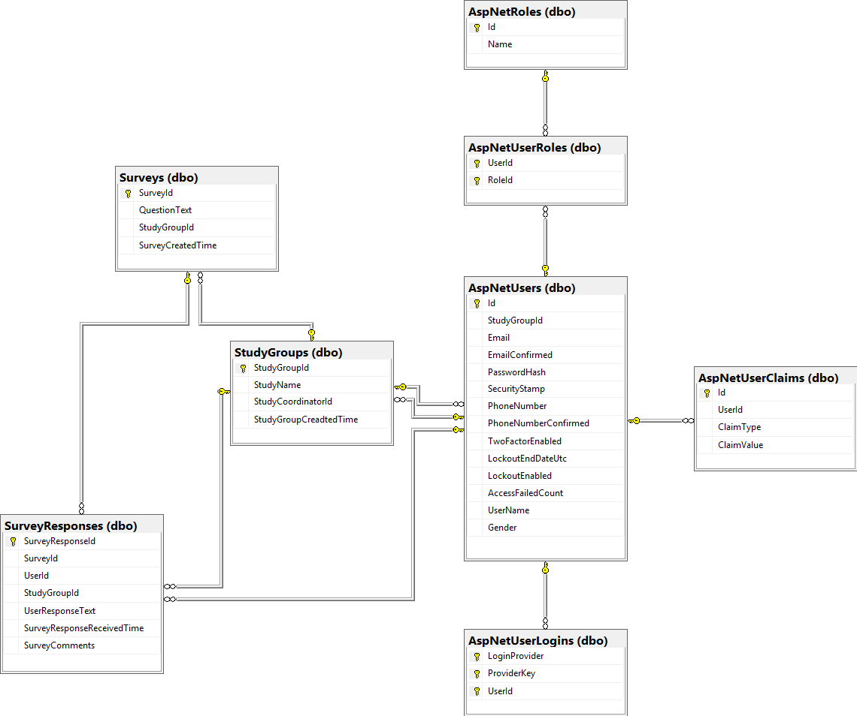
DB SCHEMA

Slide 4
API DESCRIPTION
NAME | URL | METHOD | DESCRIPTION
Login | http://caremesurvey.azurewebsites.net/oauth2/token | POST | API to get tokens for the users
Add User | http://caremesurvey.azurewebsites.net/api/Account/AddUser", | POST | The Admin User will add the user using this API
Generate Survey | caremesurvey.azurewebsites.net/api/GenerateSurvey | POST | Generates the Survey
Get Study Groups | caremesurvey.azurewebsites.net/api/StudyGroups | GET | Gets the study Group that the user has been assigned to by the Admin.
Get Surveys | http://caremesurvey.azurewebsites.net/api/Surveys | GET | Gets the survey of the study group that the logged in user has been assigned to.
Post Response | caremesurvey.azurewebsites.net/api/SurveyResponses | POST | Will send the responses of the user to the server.
Get Users | http://caremesurvey.azurewebsites.net/api/Users | GET | Gets the list of Users.
Get Responses | caremesurvey.azurewebsites.net/api/SurveyResponses?studyGroupId=1 | GET | Gets the responses and their calculations.

Slide 5
MOBILE APP

Slide 6
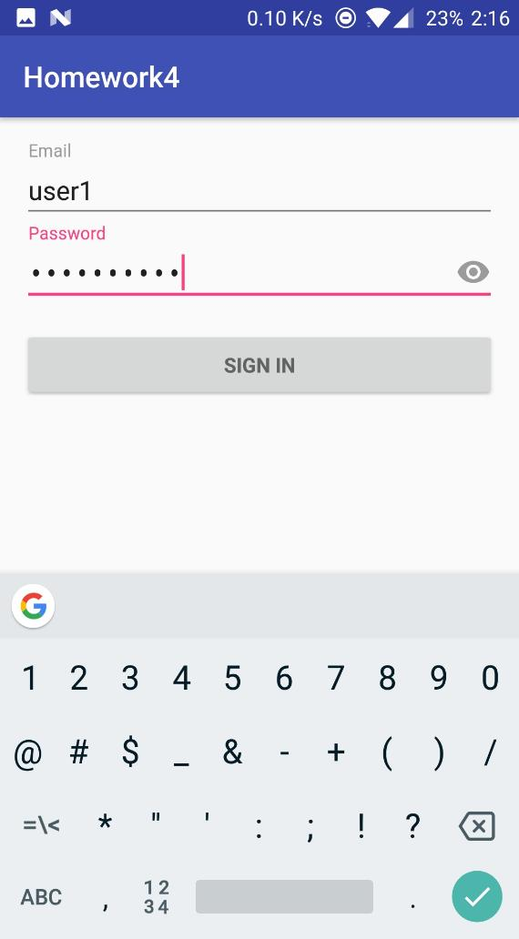
1
Login for Users.

Slide 7
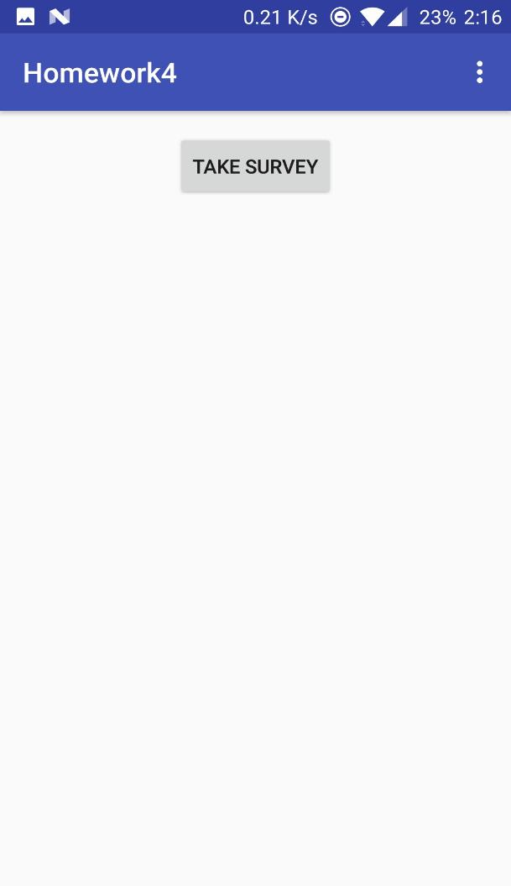
2
The user proceeds to the survey

Slide 8
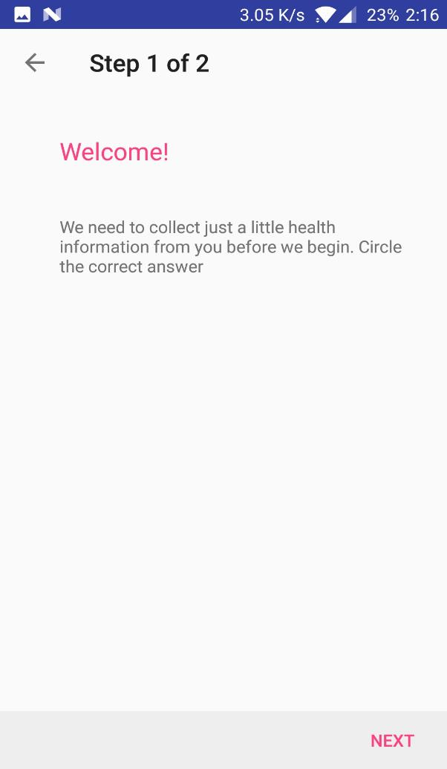
3
User consent to collect the responses.

Slide 9
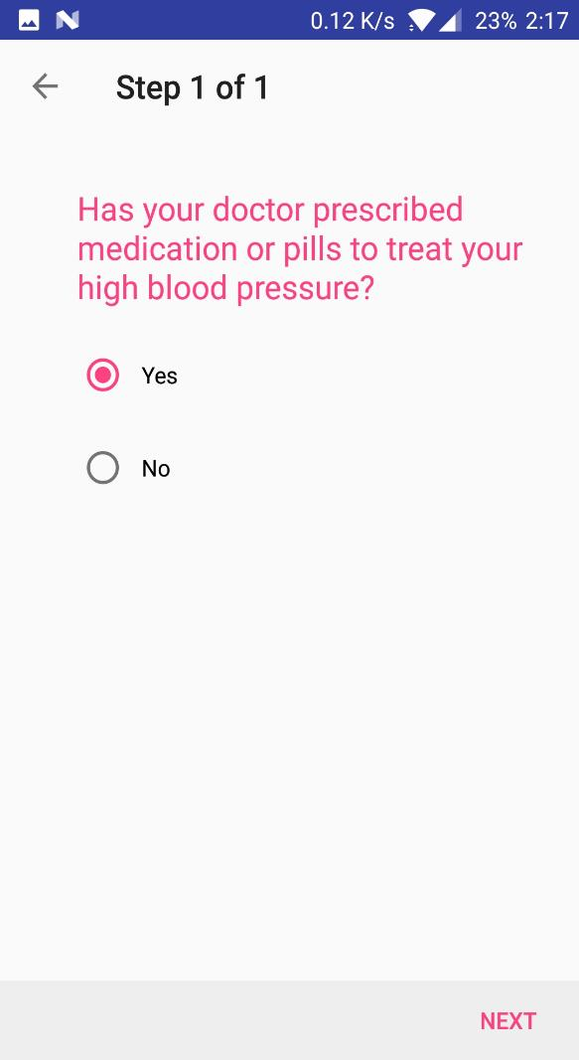
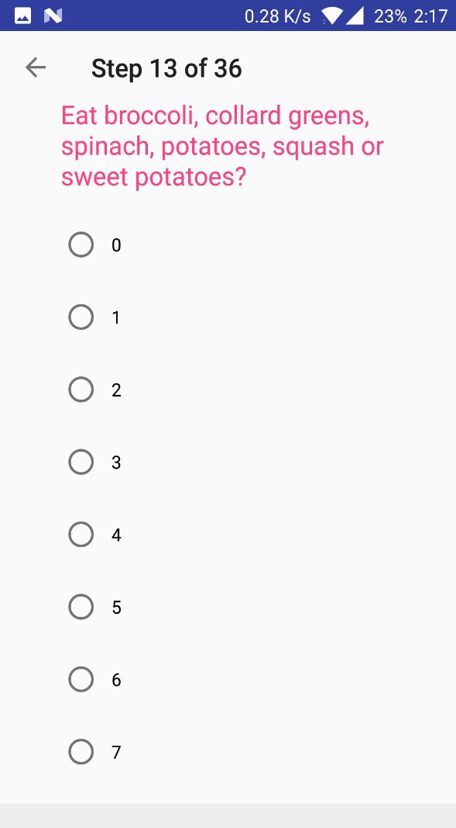
4
Questions and possible responses.

Slide 10
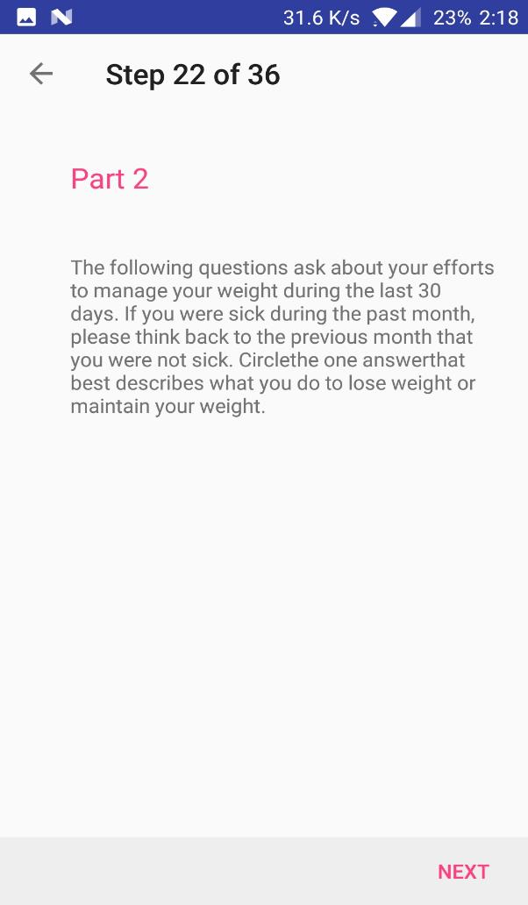
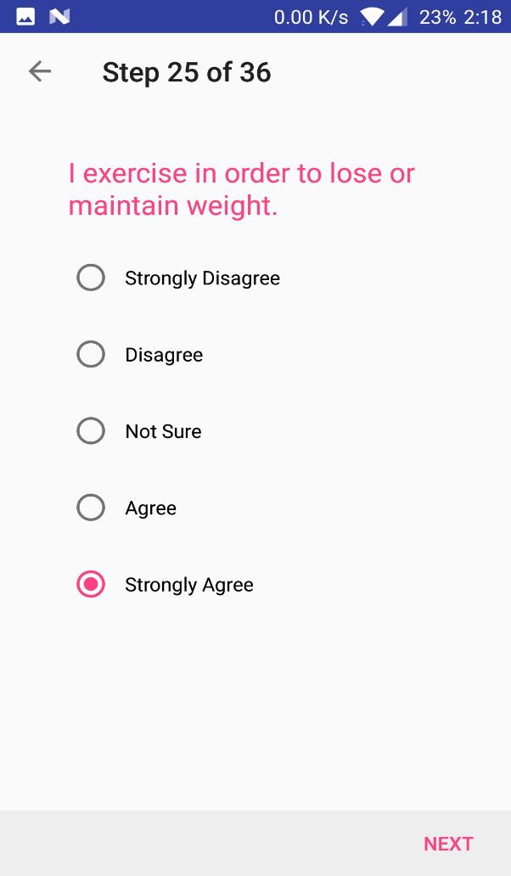
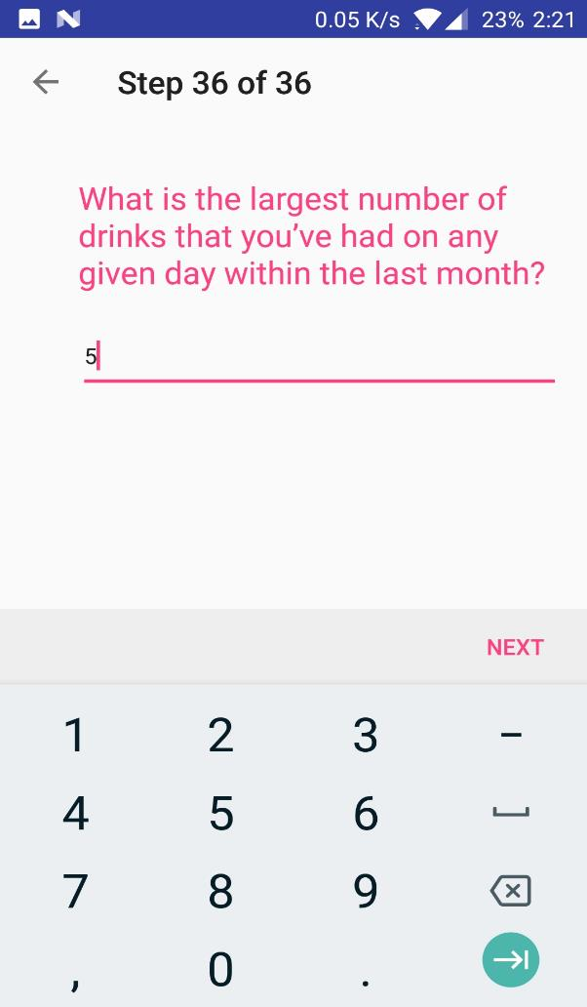
6

Slide 11
WEB APP

Slide 12
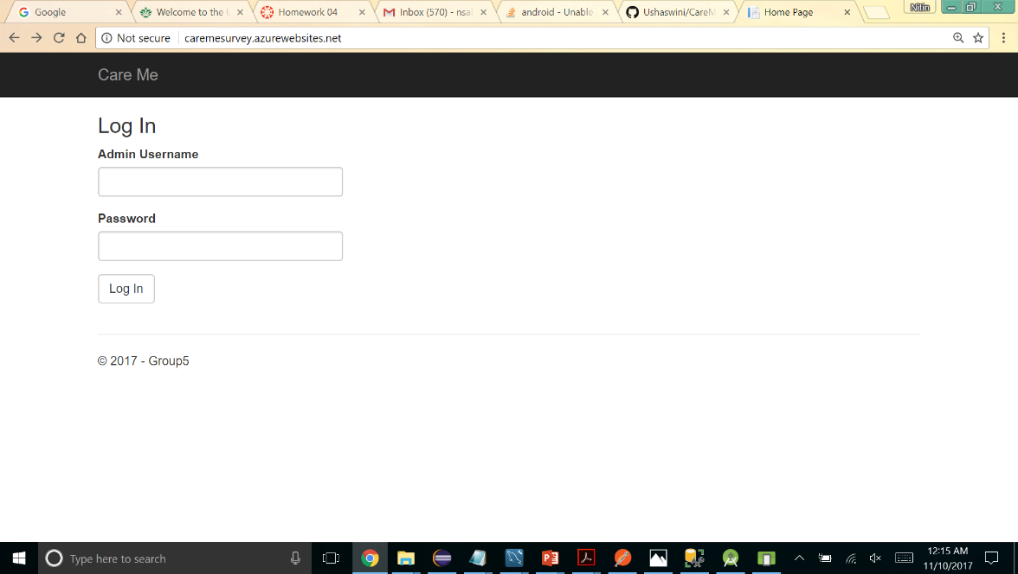
7
Web App Login Screen.

Slide 13
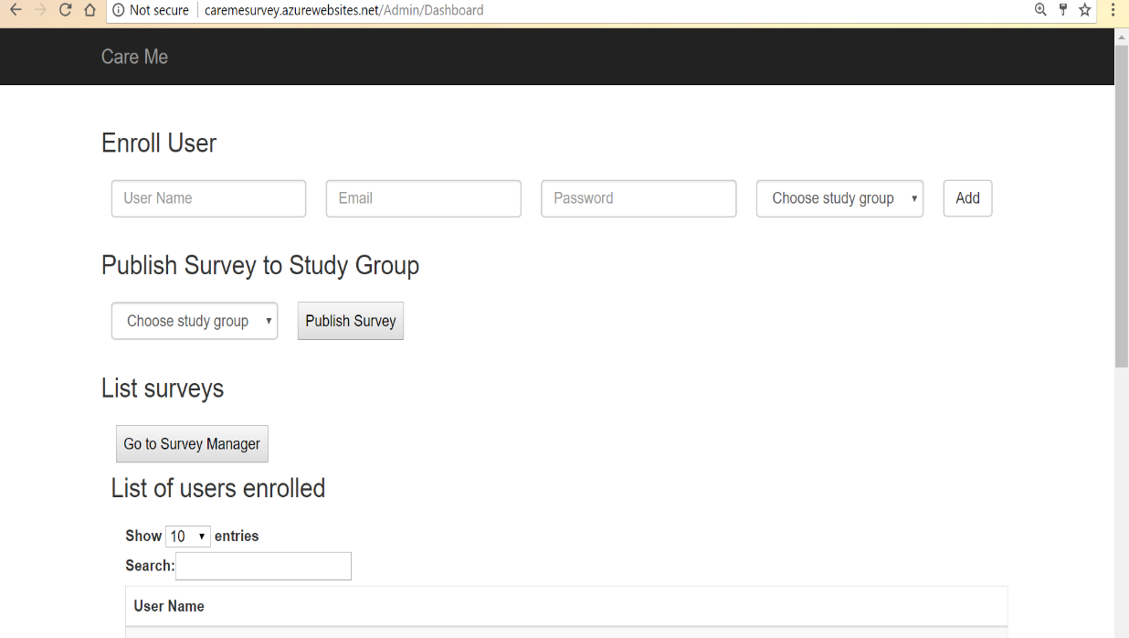
8
Admin Dashboard

Slide 14
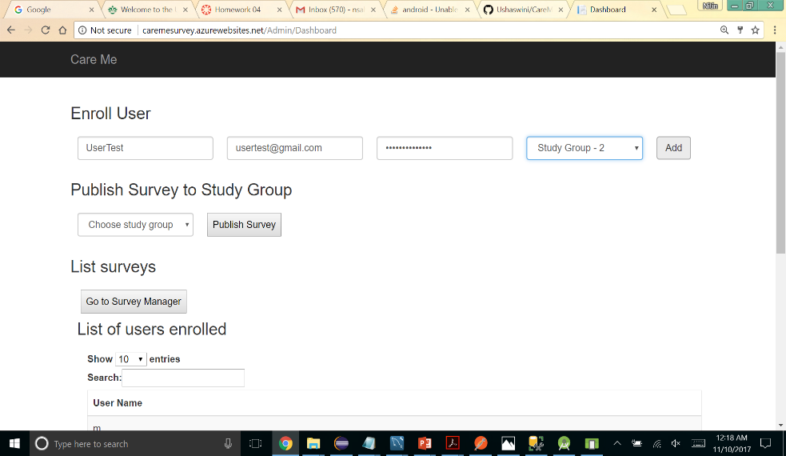
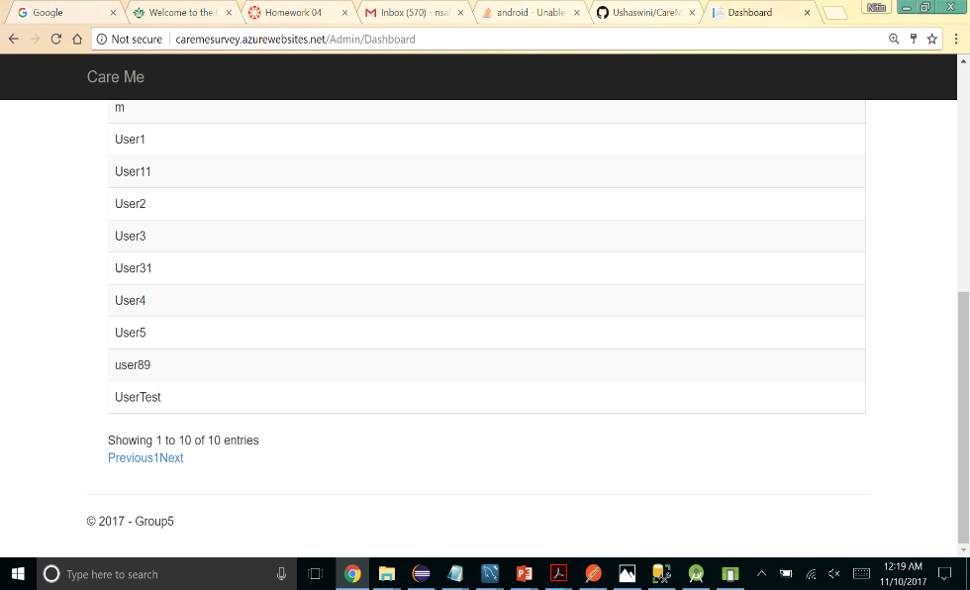
10
User added
9
Add User

Slide 15
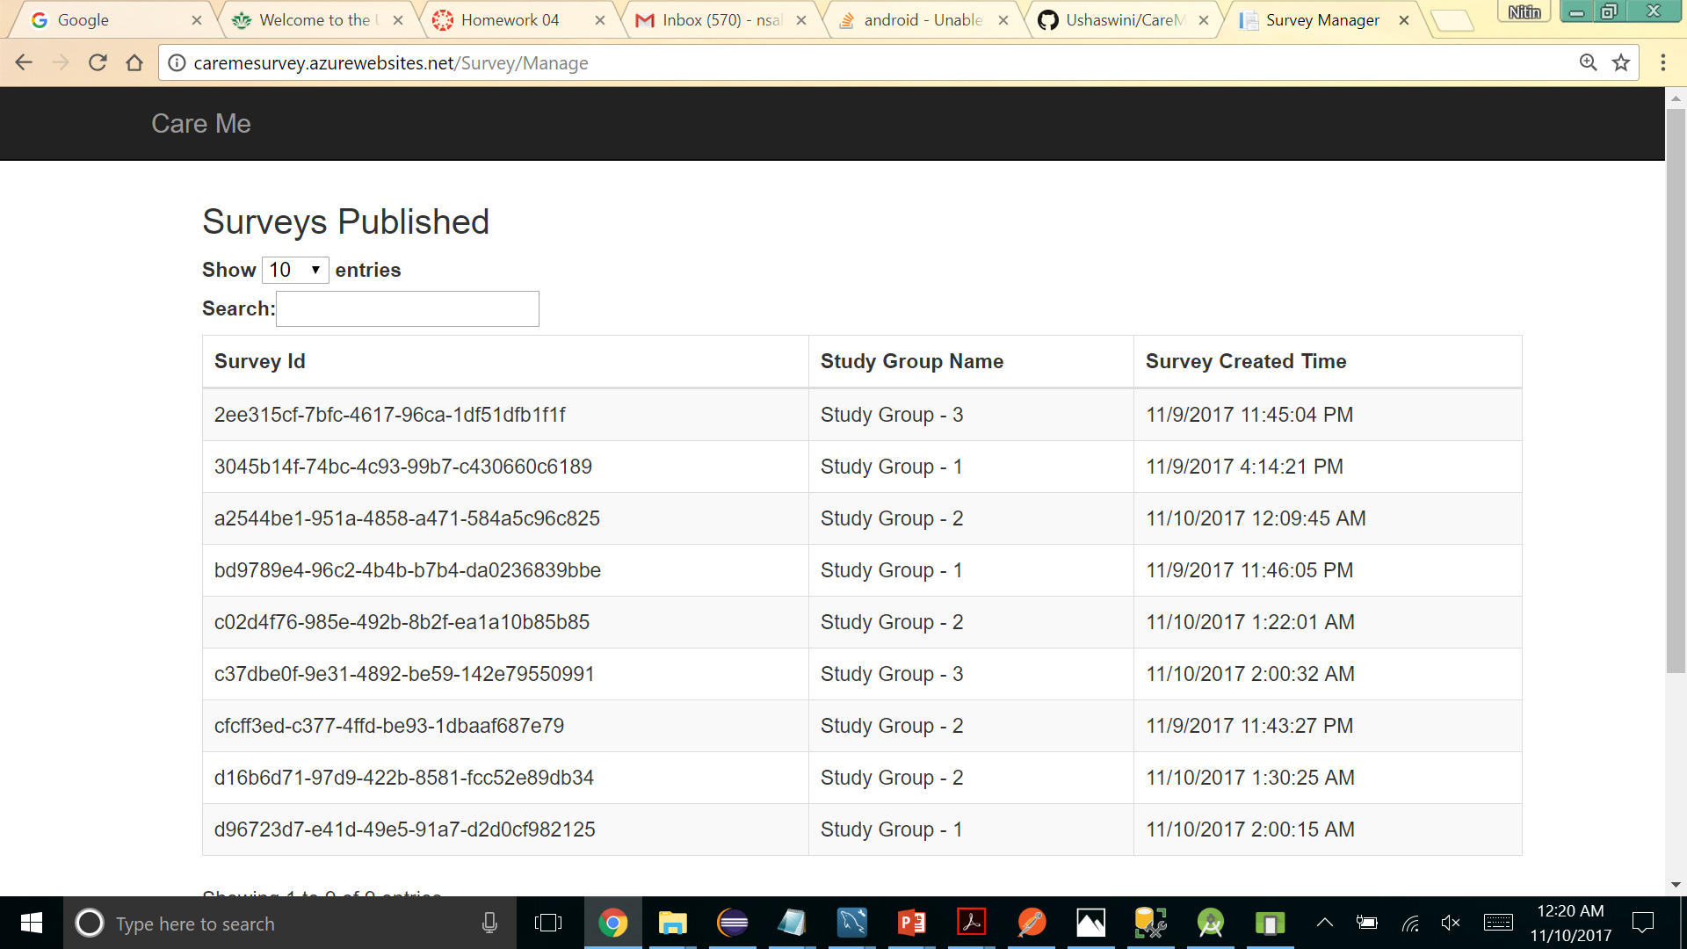
11
Published Surveys

Slide 16
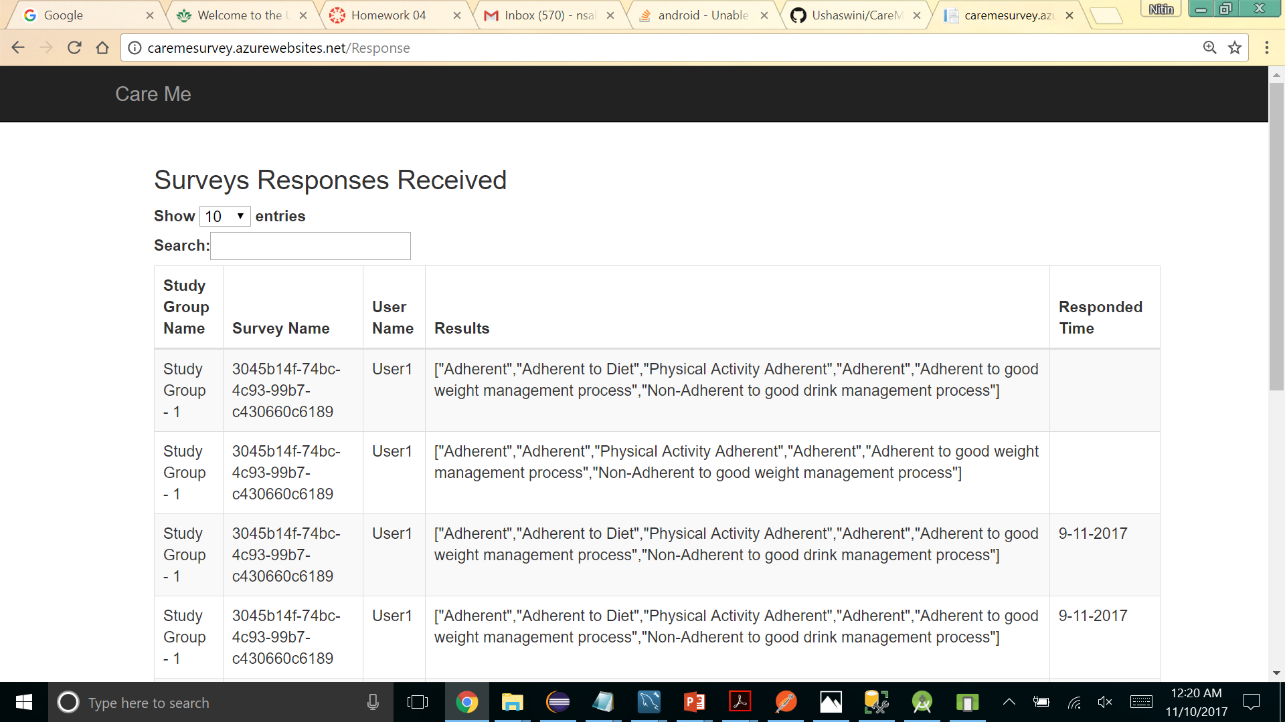
12
Survey Responses

Slide 17
THANK YOU

